Slide 1

2_Class Activity 06.07.2020 Case 2B-3 : Team5
Javid Azimi Boulali <A00829592@itesm.mx>
Antonio Osamu Katagiri Tanaka <A01212611@itesm.mx>
Julio Alberto Cao Romero Gallegos <A01327704@itesm.mx>
Bryan Iván Quintanar Abarca <A01751178@itesm.mx>
07 Jul 2020

Slide 2
Agenda
<a point for discussion> : <5min
<another point for discussion> : ~20min

Slide 3
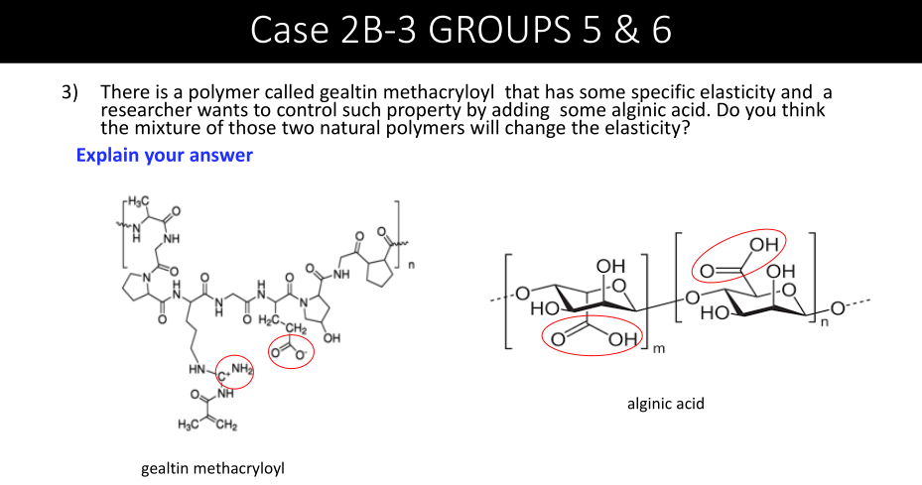

Slide 4
Phenomenon and Problem Explanation
The purpose of using the additive (alginic acid) is to tune the composite (gealtin methacryloyl) to provide a viscoelastic property to mimic extracellular matrix which is used to study living cells interaction.
The researcher wants to use alginic acid as an additive to modify the elasticity of gealtin methacryloyl and produce methacrylate-alginate (Gel-Alg). A major problem would be a lack of compatibility of both materials, resulting in compromised poperties such as: thermal stability or even chemical stability.
[1] Y. X. Chen, B. Cain, P. Soman, Gelatin methacrylate-alginate hydrogel with tunable viscoelastic properties, AIMS Mater. Sci. 4 (2017) 363–369. https://doi.org/10.3934/matersci.2017.2.363.

Slide 5
Available Information & Assumptions
Results obtained from creep and compressive tests reveal that the alginate component of Gel-Alg composite, can be effectively crosslinked, un-crosslinked and re-crosslinked by adding or chelating calcium ions.
Polymers use a combination of strong permanent crosslinks and weak bonds that could reversibly break and re-form, to generate a viscoelastic response.
Ions (CaCl2) solution was used to ionically crosslink the alginate component of the UV-crosslinked composite affecting insignificantly its mechanical properties.
In Gel-Alg, the re-crosslinked states exhibit similar viscoelastic properties to the crosslinked state, confirming that
crosslinking is reversible and this process is capable of dynamically controlling the elastic recovery
[1] Y. X. Chen, B. Cain, P. Soman, Gelatin methacrylate-alginate hydrogel with tunable viscoelastic properties, AIMS Mater. Sci. 4 (2017) 363–369. https://doi.org/10.3934/matersci.2017.2.363.

Slide 6
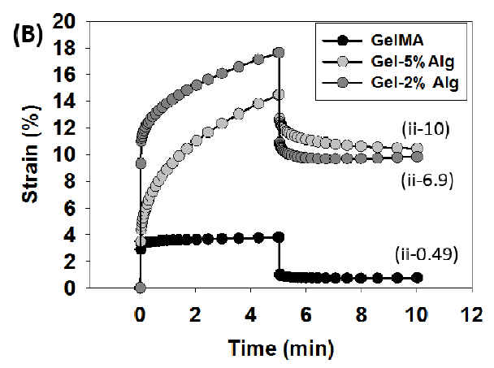
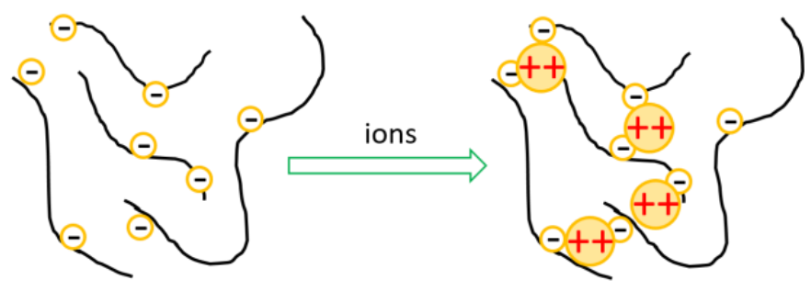
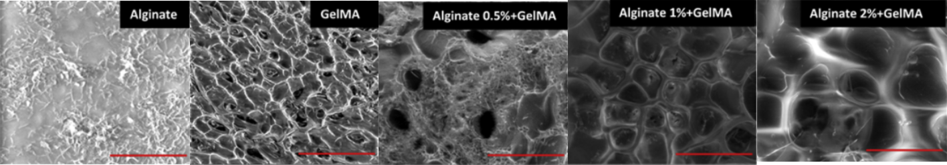
Solution & Justification
The addition of alginate increases the elasticity of the solution, caused by the creation of calcium ions. Hence the ionic crosslinking being responsible for the increase in elasticity.
Compressive creep strain plot. Taken from [1]
0.09 kPa
0.77 kPa
0.41 kPa
4.61 kPa
10.67 kPa
[1] Y. X. Chen, B. Cain, P. Soman, Gelatin methacrylate-alginate hydrogel with tunable viscoelastic properties, AIMS Mater. Sci. 4 (2017) 363–369. https://doi.org/10.3934/matersci.2017.2.363.
[2] R. Kadri, J. Bacharouch, K. Elkhoury, G. Ben Messaoud, C. Kahn, S. Desobry, M. Linder, A. Tamayol, G. Francius, J.F. Mano, L. Sánchez-González, E. Arab-Tehrany, Role of active nanoliposomes in the surface and bulk mechanical properties of hybrid hydrogels, Mater. Today Bio. 6 (2020) 100046. https://doi.org/10.1016/j.mtbio.2020.100046.

Slide 7
Conclusions:
This work demonstrates that Gel-Alg is capable of tuning its viscoelastic strain and elastic recovery properties, and can be potentially used to design extracellular matrix mimicking hydrogels.
<Conclusion B>

Slide 8


Slide 9
References
<reference A>
<reference B>

Slide 10
<Sub-title>
<content> <key concept>

